Slide 1
Dunder Mifflin Paper Company Sales Analysis

Slide 2
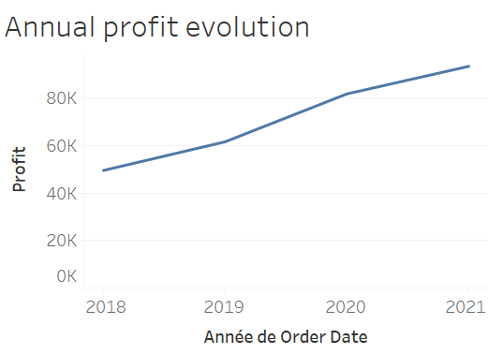
KPI 01 : Annual profit

Slide 3
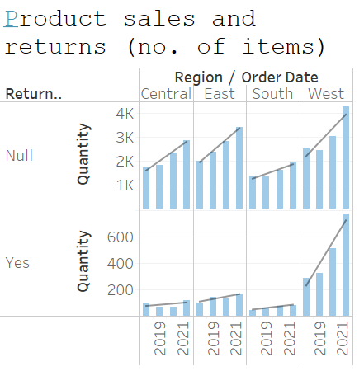
KPI 02 : Sales by region
KPI 03 : Sales by year
KPI 04 : Articles returned by region
KPI 05 : Articles returned by year

Slide 4
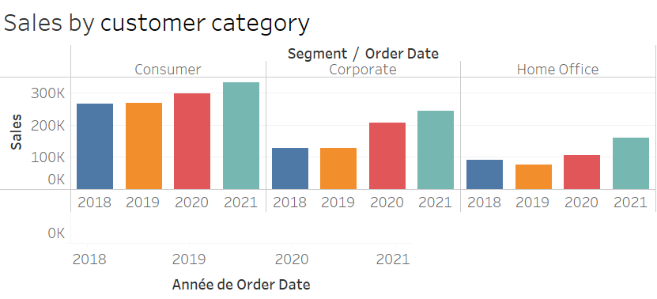
KPI 06 : Sales by customer catgory

Slide 5
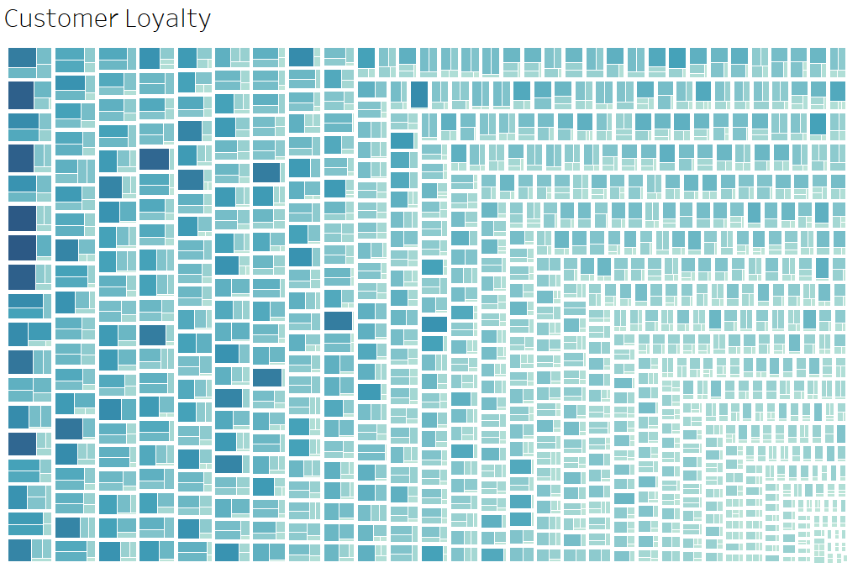
KPI 07 : Customer Loyalty

Slide 6
